Slide 1
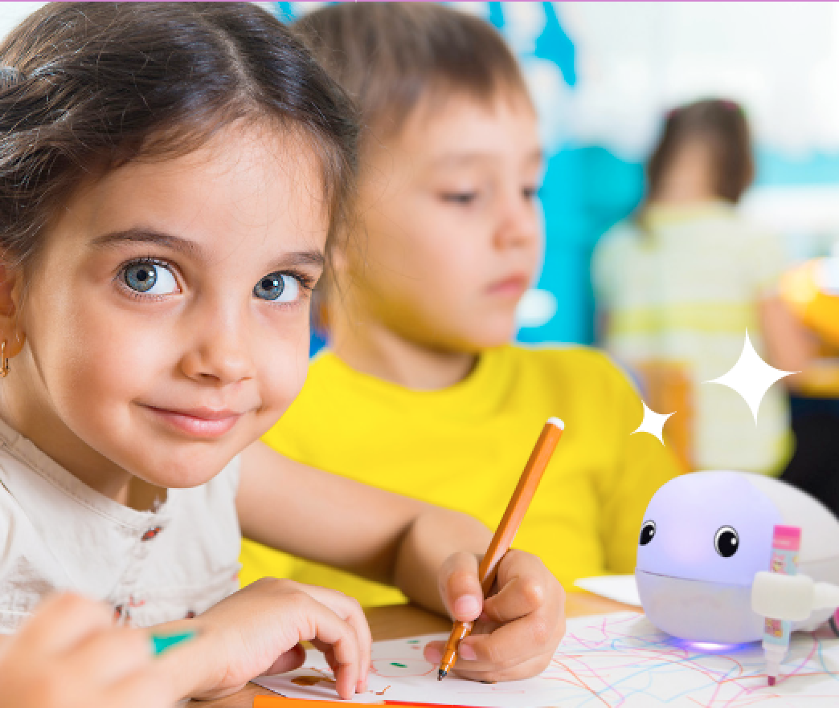
Plobot Playground
Workshop 5

Slide 2
Who knows what a loop is?
Notes:
something that keeps repeating

Slide 3
Who knows what a sensor is?

Slide 4
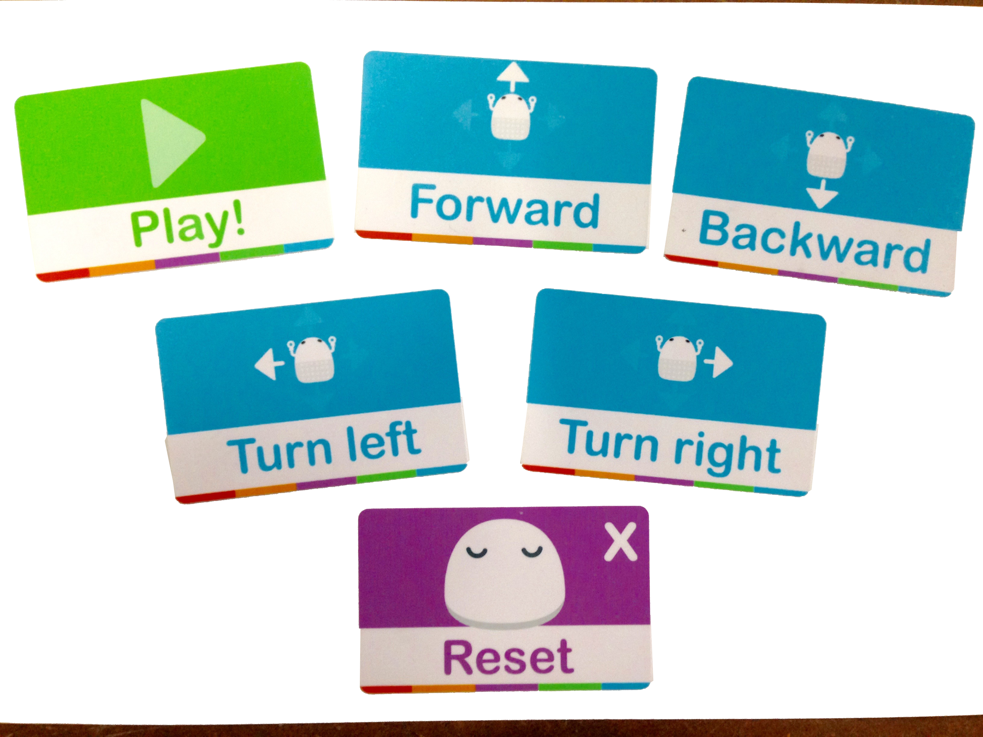
Notes:
Have kids guess what each card does

Slide 5
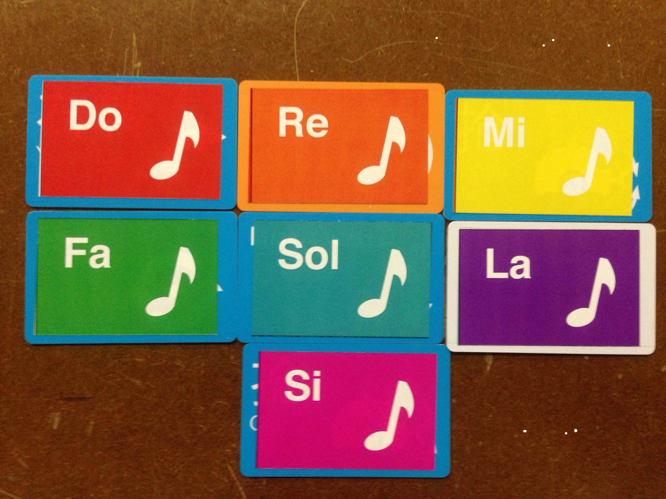
Notes:
Today we have new cards for everyone, what do you think they do?

Slide 6
with these cards you can help plobot do some cool things

Slide 7
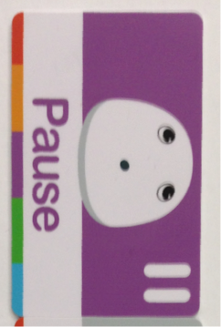
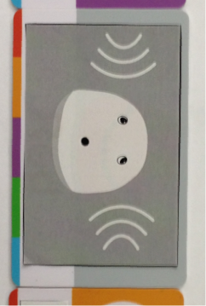

Notes:
When Programming Plobot you can tell it to wait for a second
or you can tell it to wait for something else to happen
if we use these two cards, Plobot will pause and wait for a loud sound before moving again
Lets try it now

Slide 8
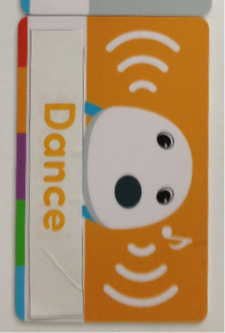
Notes:
This card lets you put Plobot in “Dance” mode when programming
In Dance mode the lights flash faster and you can program notes or movements
Once you’re done with the song or dance you can use the “Dance” card to put it back to normal mode
Lets have Plobot move forward, then do a song and dance, and then come back to us.

Slide 9
with these three cards you can help plobot do some cool things

Slide 10
these are challenges for you

Slide 11
if you complete one challenge you can work on the next one

Slide 12
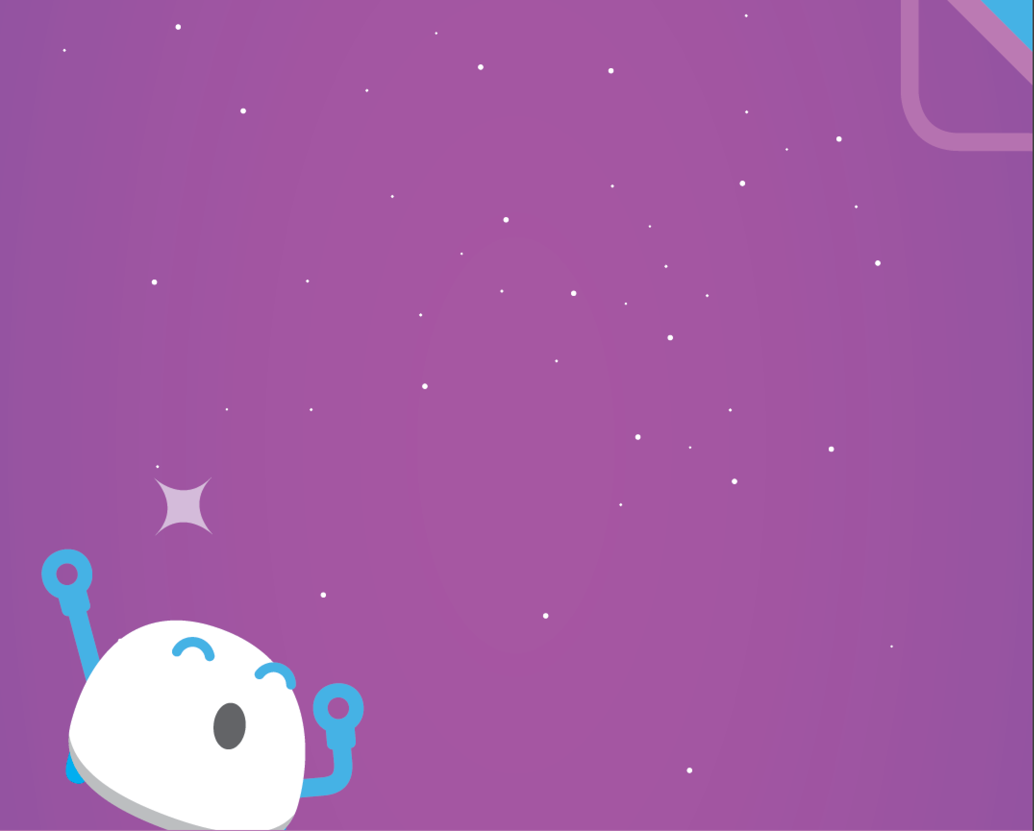
today i want to tell you more about plobots

Slide 13
plobots are not like people, people don’t like to do things over and over again

Slide 14
but plobots love it!

Slide 15
we teach plobots what to repeat by using a new card

Slide 16
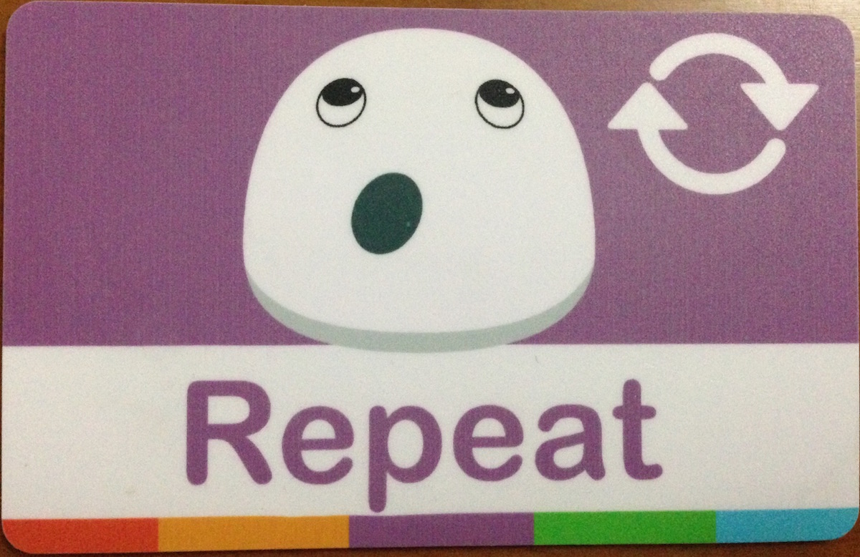
one new card - repeat

Slide 17
using loops (repeats) we can teach plots to do same thing many times, or even find shortcuts in how to get plots to solve problems

Slide 18
to teach plobots what to repeat first we scan the repeat card

Slide 19
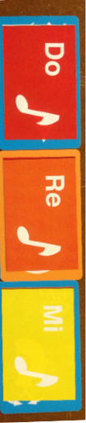
then we teach it what we want to repeat, lets try a simple song:

Slide 20
and then we tell it that this is all we want by scanning repeat card again

Slide 21
if we want our plobot to sing that song 4 times all we have to do is scan repeat 4 times

Slide 22
lets see what happens when we tell plobot to play

Slide 23
what things do you have to do over and over that you don’t like?

Slide 24
with plobots lets start with something simple

Slide 25
TEACH Plobot go away from you, turn around, and come back to you
use turn left (or right) card only one time in your “program”
use repeat as many times as you need
orange - level

Slide 26
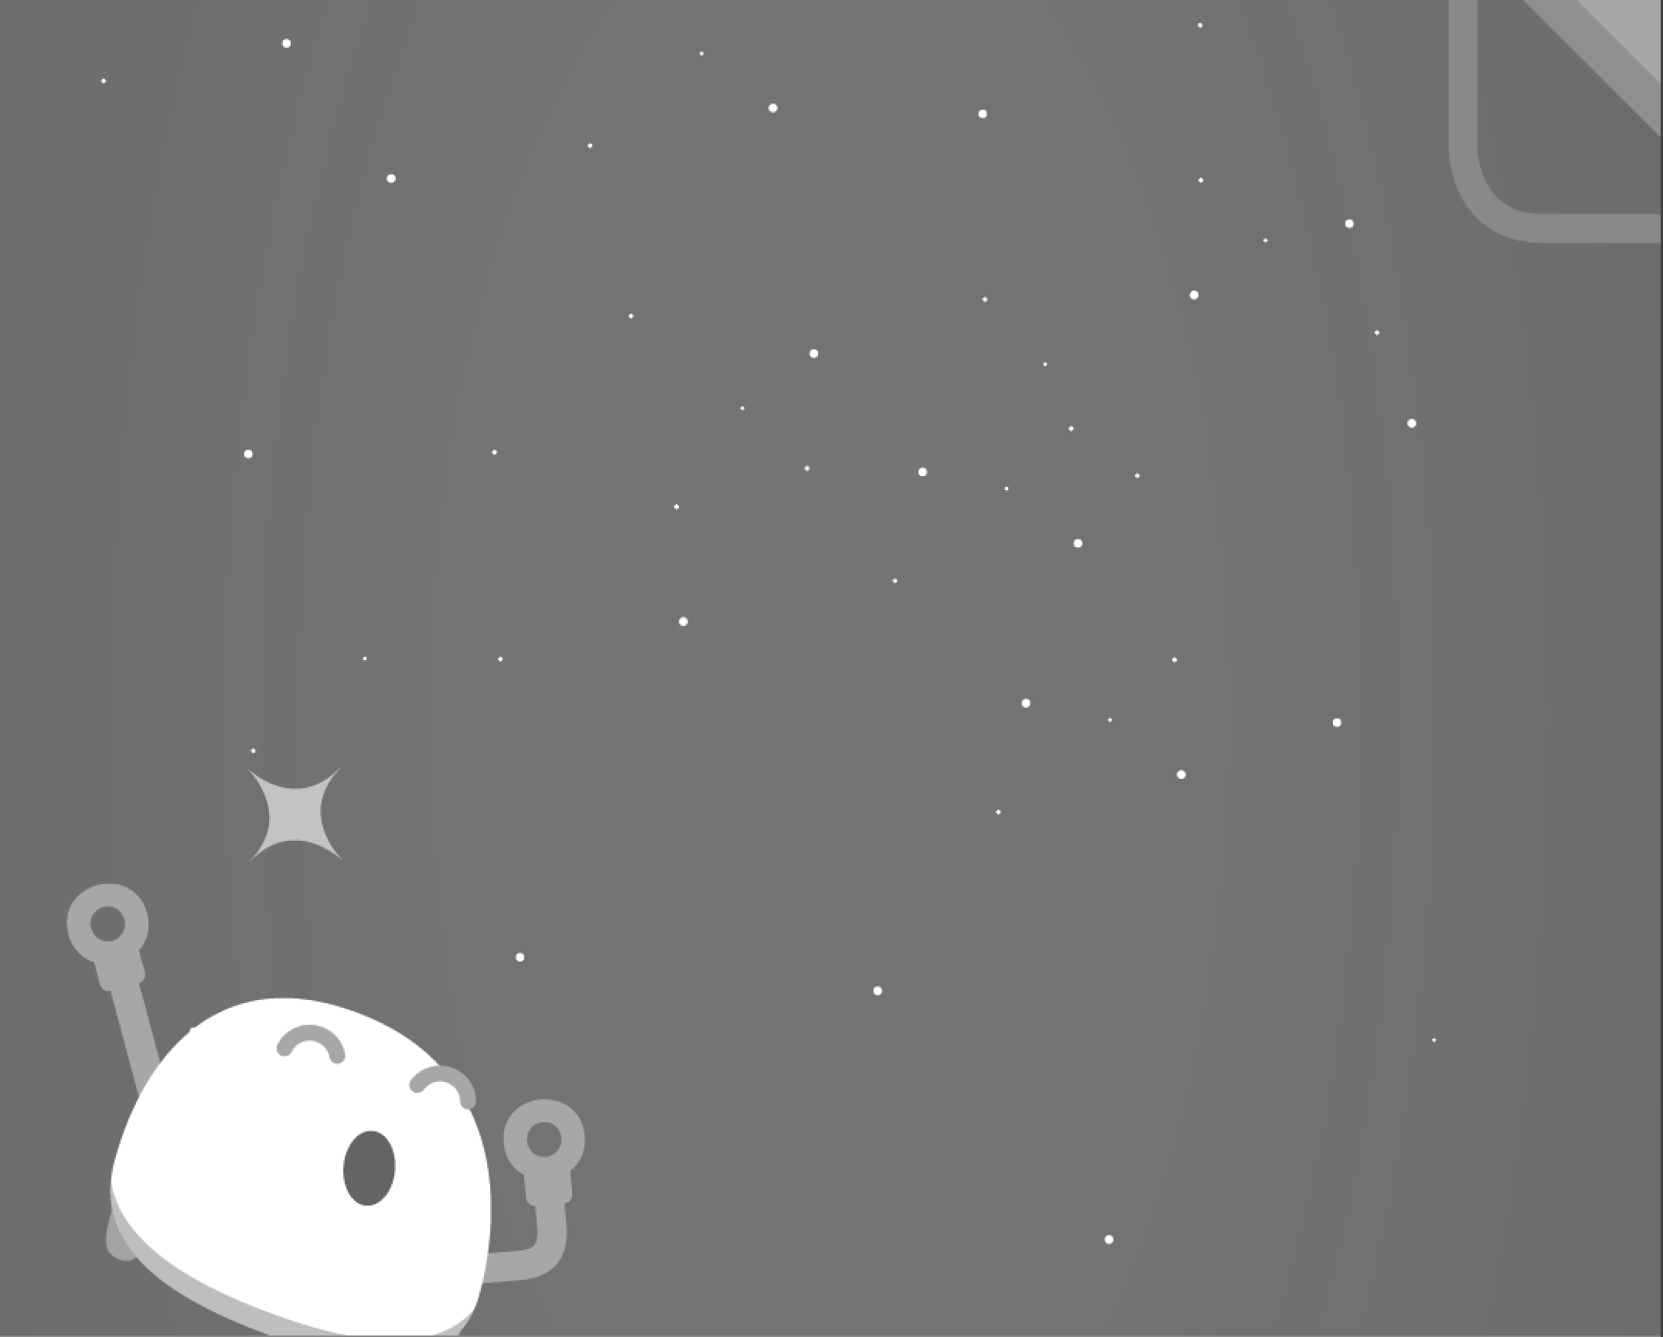
now our plobots are ready to try something harder

Slide 27
lets have the plobot sing same song in 3 different spots

Slide 28
Teach Plobot to sing same song in 3 different places:
go to a location & sing song
go somewhere else & sing same song
go to last location & sing same song
red - level
Notes:
Plobots get bored waiting for a tap or clap, so after 10 seconds they will continue doing whatever they are supposed to be doing

Slide 29
you are doing well!

Slide 30
do you guys remember how to make plobot dance?

Slide 31
maybe we can make plobot do the same song and dance a few times?

Slide 32
teach Plobot to:
go forward
perform song and dance
go forward 3 times
perform same song and dance
go back 4 times
perform same song and dance
green - level
Notes:
We'll have all Plobots lined up and get them all to play music together.

Slide 33
you are amazinG! Plobots are learning so fast!

Slide 34
can you come up with a cool way of using the repeat card?

Slide 35
teach Plobot to:
do something cool
purple - level

Slide 36
thats really impressive!

Slide 37
maybe now we can have all our plobots do something cool together

Slide 38
first thing we need is to have plobot to wait for a sound or tap to begin

Slide 39
do you remember how to do that?

Slide 40
great! now have plobot do something even cooler…whatever you want!

Slide 41
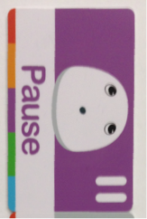
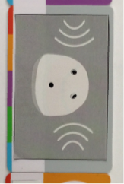
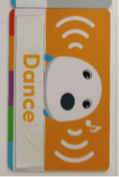
Lets teach all Plobots to:
wait for clap or tap
do something super cool!
put all plobots together and have them do cool things together
Blue - level
ALL TEAMS

Slide 42
good job everyone!
Notes:
We helped Plobot do many things today. When we talk to Plobots we have to remember to tell them things in the correct order (sequence) so that they do what we want them to do. But if we screw up its ok, we can have the Plobots forget and start over.

